Slide 1
General Meeting
April 4th 2013
WCH 205/206

Slide 2
Ice Breaker
Easter Egg Hunt
Spell out Bourns Engineering Day

Slide 3
Upcoming Events
Bourns Engineering Day
Professional Development Conference
Evening With Industry
Resume Book
NEW: Officer Position Openings
Spring Sports Team
(init) Together Competition

Slide 4

Bourns Engineering Day
THIS SATURDAY
810+ registered participants

Slide 5
Init(Together)
April 14th
UC Irvine
Conference provides mentorship and guidance for
women with a future background in computing.
Networking opportunities, there is an opportunity to get a mentor in a field we are looking forward to pursing.

Slide 6
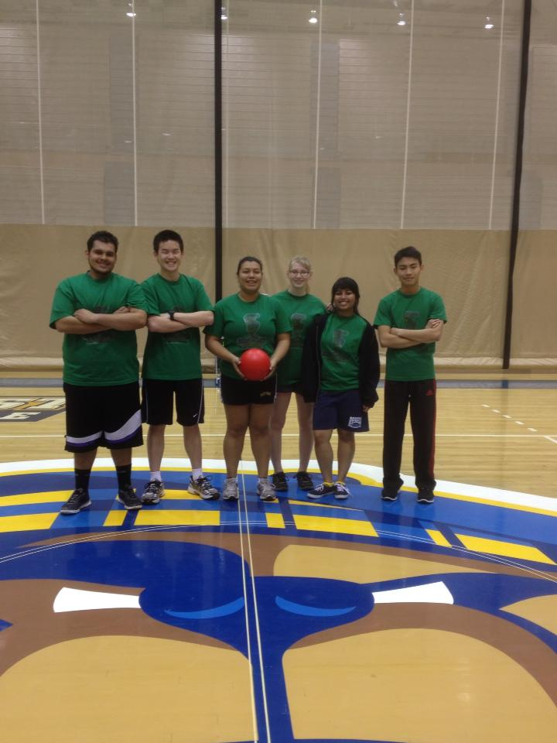
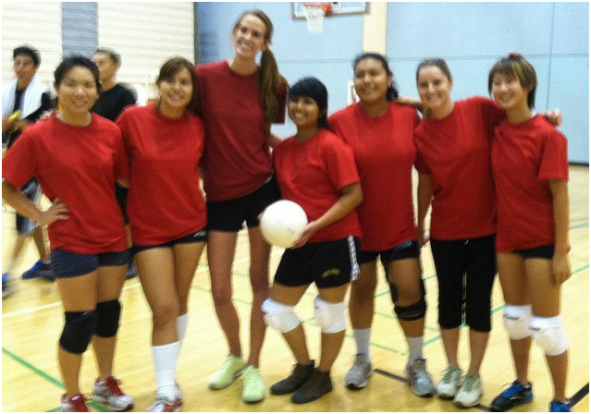
Spring Sports Team

Slide 7

Professional Development Conference
Costa Mesa, CA
April 20th, 2013

Slide 8
NEW Officer Positions
Newsletter Editor
Public/Member Relations Chair
Ambassador
Mentor Program Chair

Slide 9
Etiquette Dinner
April 24th Wednesday 6-9PM
HUB 302
Learn how to eat properly around professionals
Prepare for the Evening with industry

Slide 10

Evening With Industry Event
Wednesday, May 1st
6-9 PM
3 course meal with company representatives
10- 15dollars

Slide 11
Next Meeting
Professional Development Theme
Bring laptops
Bring Resume
Bring yourself

Slide 12
Social Activities
Night laser tag at Bourns
Water Day
Bowling
Evening Hike to the C

